Slide 1
Applied Parallel Computing with Python – Lessons Learned
PyCon 2013

Slide 2
Goal
Scalable, robust systems in the face of increasing unreliability
Reporting and debugging to quickly fix problems
Parallelising CPU-bound and disk-bound tasks
Visualisations for communication

Slide 3
Taught before
CPU-bound profile(runsnake, line_profiler)
CPython objects & numpy
Compilation (cython, shedskin)
Efficient memory access (numexpr)
Multi-core (multiprocessing)
Multi-machine (pp, iPython Cluster, PiCloud)
CUDA

Slide 4
About me (Ian Ozsvald)
Data Science consultant for 14 years
Python for 9 years (C, NLProc.)
SocialTies and Headroid at EuroPythons
StartupChile computer vision
Annotate.io NLP on social media
ShowMeDo.com co-founder
IanOzsvald.com - MorConsulting.com

Slide 5
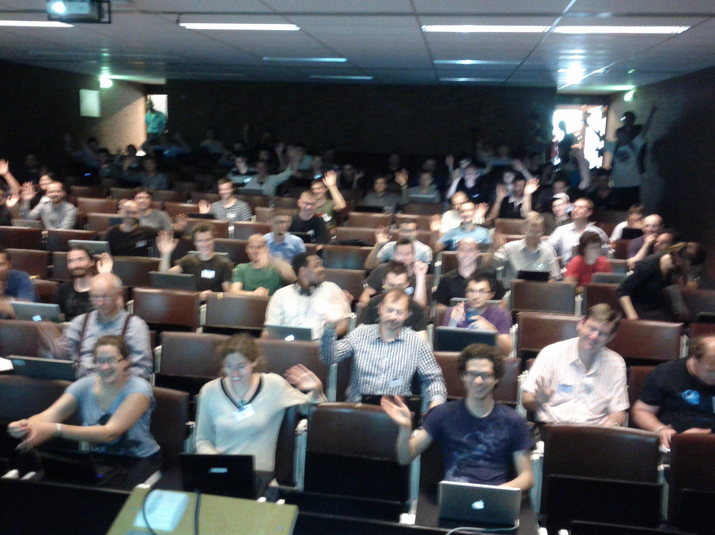
Group photo
I'd like to take a photo - please smile :-)

Slide 6
Scalability
You won't specify it correctly
It will break
Separability – for scaling and testing
Vertical and Horizontal
Bottlenecks? CPU/Disk/Mem/Network
Assume cluster size will change (best – during production)

Slide 7
Coding
VirtualBox/Vagrant – match deploy env
Design for e.g. dev/test/staging/prod envs
  Enable upgrade/refactor testing
Tuples bad, dicts ok, classes better
Use JSON for persistence

Slide 8
Robustness
Assume failures occur
Assume capacity constraints
Test driven development
Specify what's required in each system
“Notes on Distributed Systems for Young Bloods” http://www.somethingsimilar.com/2013/01/14/notes-on-distributed-systems-for-young-bloods/

Slide 9
Queueing approaches
Random queue choice dangerous
Must not flood queues
  Use timeouts, retries
  Check capacities

Slide 10
Reporting
Server Density
StatHat
Greylog central logger

Slide 11
Tool choices
Gael's joblib
Avoid NIH - Celery
Consider range of errors that can occur (e.g. Connection dropped, 500 int error, unknown URL)
Glances/htop, dsniff, lsof, iftop, netstat
supervisord, circus, upstart
fabric, puppet

